Slide 1
Bayesian Meta-Analysis-II
(Examples)
Fish 558; Day 5: 10h30-12h00

Slide 2
Overview
Dorn (2002):
  Stock-recruitment steepness
Helser and Lai (2004)
  Growth curves
Millar and Methot (2001)
  Survey catchability

Slide 3
Stock-Recruitment Steepness
(Dorn, M.W. 2002; N. Am. J. Fish. Manage. 22:280-300)

Slide 4
Background and Objectives-I
Background-I:
  Management plans for Federally-managed species are required to include an estimate of F_{MSY} (the fishing mortality that maximizes the long-term catch) and ensure that it is not exceeded.
  F_{MSY} depends on the slope of the stock-recruitment relationship at the origin, but it is difficult to estimate this parameter (and the related “steepness” parameter)

Slide 5
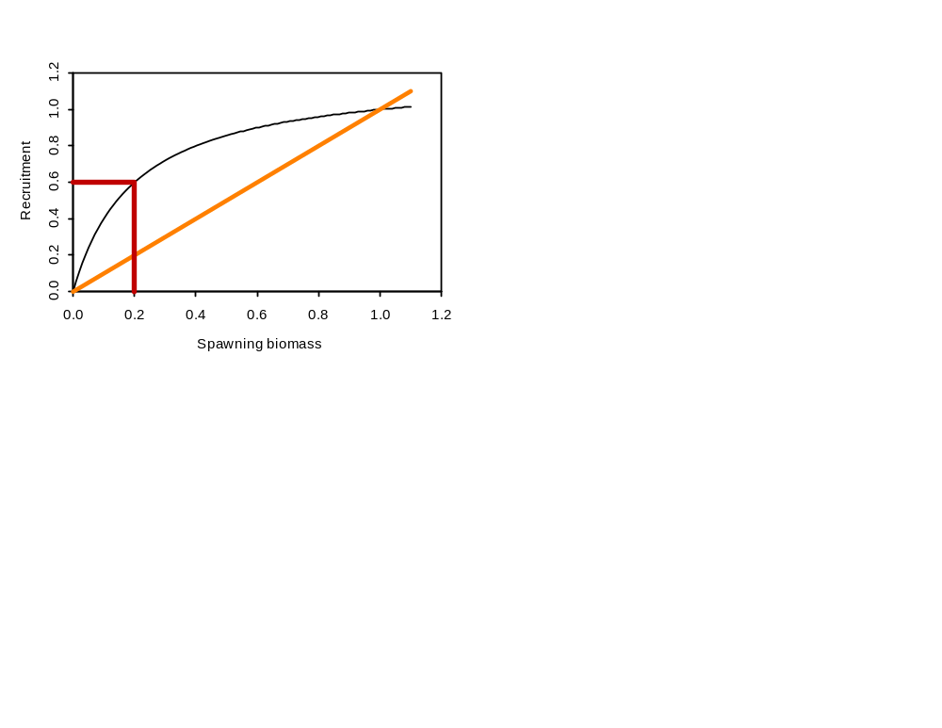
Background and Objectives-II
Background-II:
Steepness is the fraction of virgin recruitment expected at 20%
of the unfished level and might be expected to be interchangable
among species/stocks.

Slide 6
Background and Objectives-III
Objectives:
  Develop a posterior distribution for the steepness of an “unknown” rockfish stock.
  Use this posterior distribution to determine a posterior distribution for F_{MSY}.

Slide 7
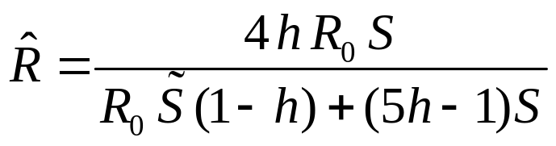
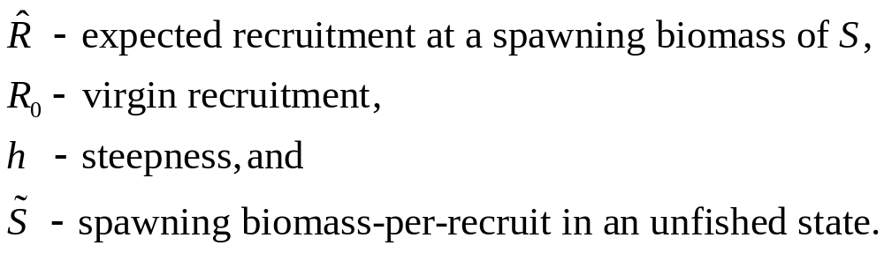

Methods-I
A reparameterized stock-recruitment relationship:
S and are assumed known for each stock/species as
well as the actual recruitment sequence.

Slide 8
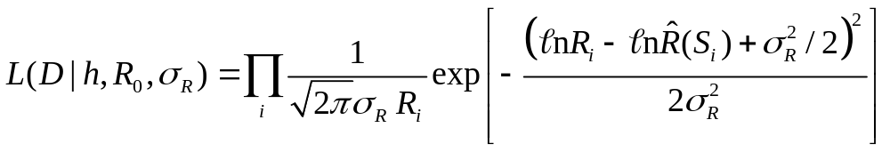
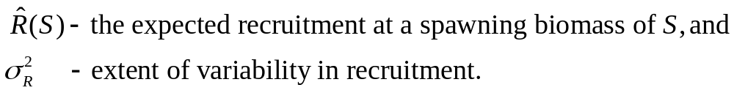
Methods-II
The likelihood function:

Slide 9
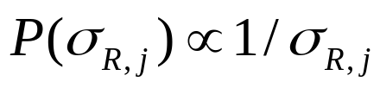
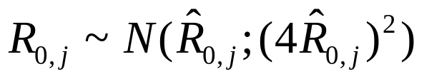
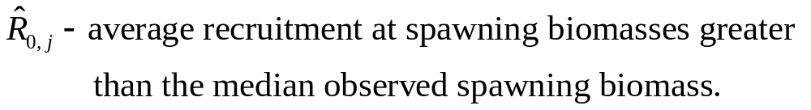
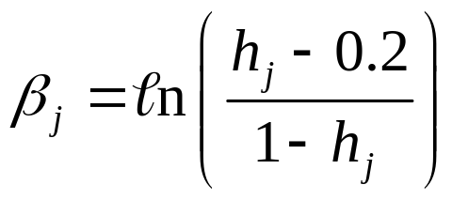
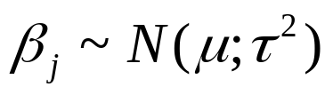
Methods-III
The priors:
j indicates stock/species j.

Slide 10

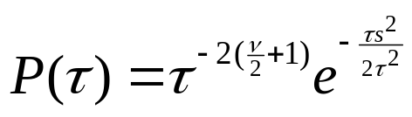

Methods IV
The hyper-priors:
The prior on τ bounds this parameter away from 0.
Implementation:
MCMC as implemented in AD Model Builder; 500,000 cycles
after a burn-in of 50,000 cycles; thinned by taking every
200th parameter vector.

Slide 11
Data Used
Species | Stock | Number of data points
Chilipepper | West coast | 28
Bocaccio | West coast | 30
Widow rockfish | West coast | 27
Canary rockfish | Washington + Oregon | 28
Black rockfish | West coast | 7
Yellowtail rockfish | West coast | 27
Pacific Ocean Perch | West coast, BC, Gulf of Alaska, Aleutian Islands, Eastern Bering Seas | 40, 26, 16, 28, 37

Slide 12
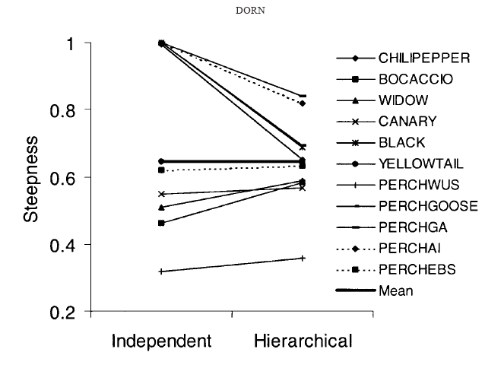
Results -I
Evidence for shrinkage

Slide 13
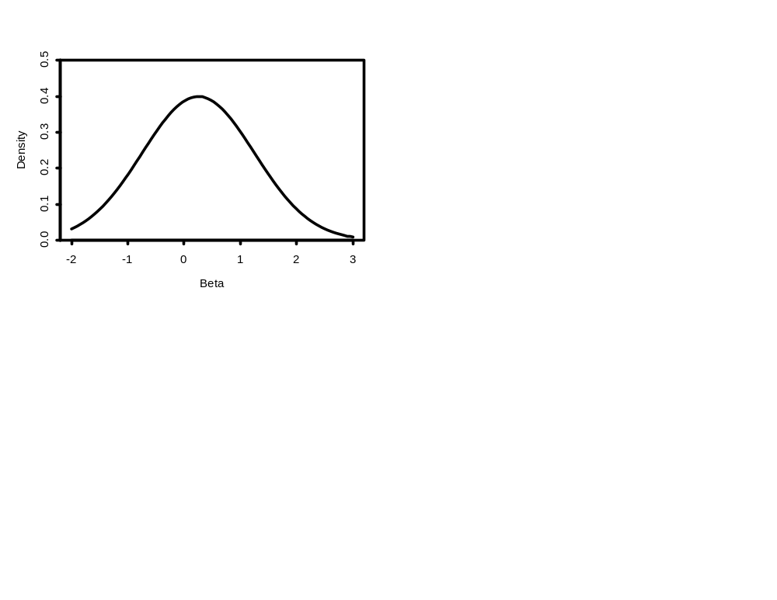
Results-II
Posterior distribution for β

Slide 14
Comments Arising-I
Outcomes:
  The median of the posterior for steepness (~0.65) has been included in several assessments of west-coast rockfish species.
  The implication that productivity for rockfish is lower than for many other fish species was one reason that the target harvest rate for west coast groundfish was reduced in 2002.

Slide 15
Comments Arising-II
Questions with the analysis:
  Are the species really interchangable; should 5 of the 11 stocks have been Pacific Ocean Perch.
  The “data” are actually model outputs. This implies that the estimates of spawning biomass are actually not known exactly and there is some correlation between the recruitment estimates (i.e. the likelihood is actually wrong).
  The results are somewhat sensitive to leaving out the data for Pacific Ocean Perch, changing the assumed functional form for the relationship between spawning biomass and recruitment (Ricker vs Beverton-Holt), and changing the assumed error structure (Gamma vs. lognormal).
  Some of the low steepness values may be caused by climate effects (ignored in this analysis)

Slide 16
Growth Curves
(Helser and Lai, 2004: Ecol. Model. 178: 399-416)

Slide 17
Background and Objectives
Background:
  Models of length-at-age are important for many types of analyses (including those on which a Decision Analysis could be based).
  There has been much focus on methods for fitting growth curves and how to model individual variation in growth, but little attempt has been made to analyze among-population variation in growth.
Objective:
  Explore the impact of geographic location on growth parameters.

Slide 18
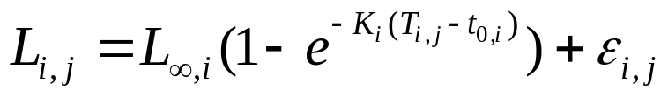
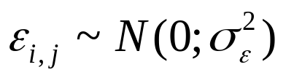
Methods-I
The multi-population von Bertalanffy growth model:
where j=1,2,…,n_{i} ages for i=1,2,…,N populations.

Slide 19
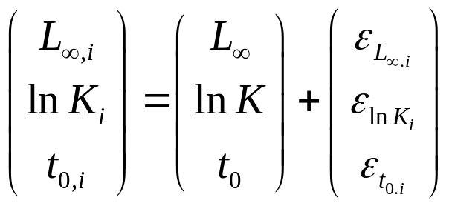
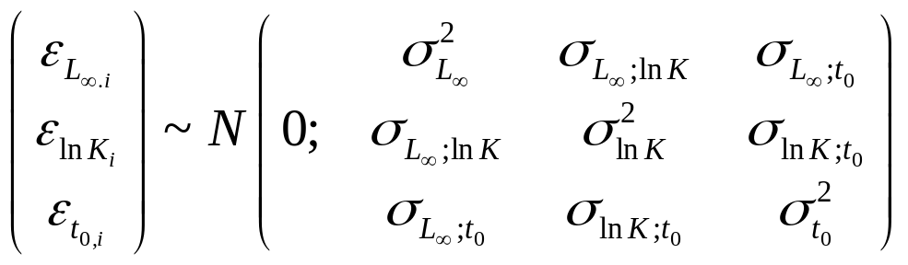
Methods-II
We can incorporate a hierarchical structure assuming all
populations are interchangable:

Slide 20
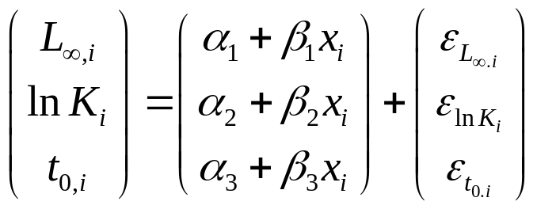
Methods-III
We can incorporate a hierarchical structure assuming all
populations are interchangable after account is taken of a
covariate:
The covariate is latitude in the example application.

Slide 21
Methods-IV
Priors:
All of the priors are assumed to be “noninformative” (flat).
Implementation:
MCMC implemented using WinBUGS.

Slide 22
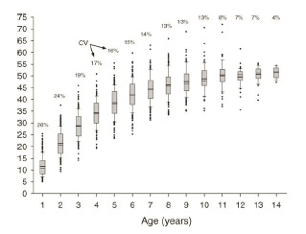
Data
Data from 245 populations of largemouth bass (out of a
possible 698 with some data).

Slide 23
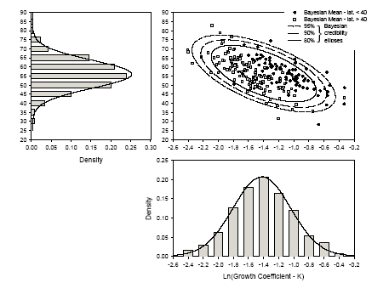
Results-I
Bayesian posterior modes for the
245 populations.

Slide 24
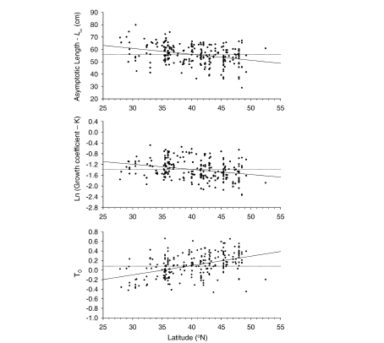
Results-II
Relationship between growth
parameters and latitude.

Slide 25
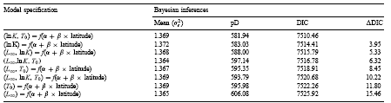
Results-III
Use of DIC to select among models.

Slide 26
Survey Catchability
(Miller and Methot, 2002: Can. J. Fish. Aquat. Sci. 59: 383-392)

Slide 27
Background and Objectives
Background:
  Swept-area surveys are conducted off the U.S. west coast and provide indices of biomass for many rockfish species.
  These indices are treated as relative (not absolute) indices of abundance. “Bulk catchability” (Q) is the ratio of swept-area biomass to true biomass.
  Q is almost certainly not 1 (escapement under the footrope; untrawlable habitat, etc.) and probably varies among species.
Objective:
  Develop a distribution for Q which could be used in assessments for (currently) unassesed stocks.

Slide 28
Methods-I
Assumptions:
  The Qs for different species / stocks are not all the same, but can be described by a underlying statistical distribution.
  Q for a species / stock varies systematically among years (there are years in which catchability was “good” and others in which it was “bad”, and this is common across species / stocks).

Slide 29
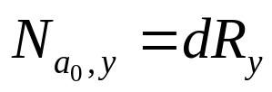
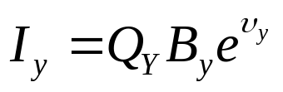
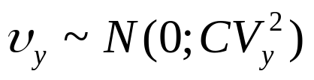
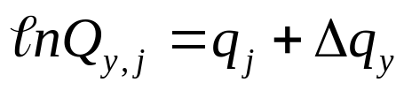
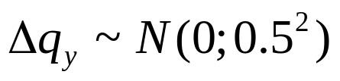
Methods-II
For a single stock:
Biomass, B_{y}, is based on an age-structured model with
parameters related to: virgin recruitment, R₀, natural
mortality, selectivity, and a “recruitment” multiplier, d,
where R_{y} is the recruitment from the actual
assessment and d is an estimable parameter. Only
uncertainty in d and R₀ is considered.
Now:
where

Slide 30
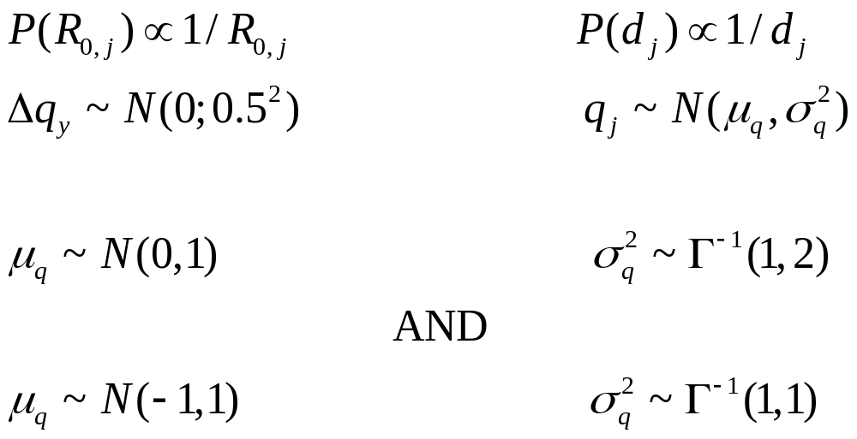
Methods-III
The priors:

Slide 31
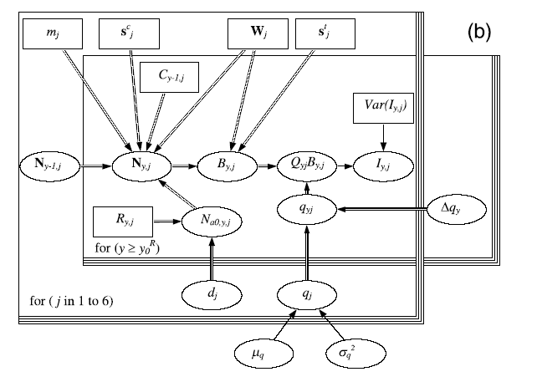
Implementation
MCMC implemented using WinBUGS; 1,000,000 cycles thinned
by taking every 2,000th vector.

Slide 32
The Data
Swept-area biomass estimates from the NMFS tri-annual shelf surveys off the U.S. west coast for 1977, 1980,…,1998.
Species / stocks
  Bocaccio, canary (south), canary (north), chilipeper, widow, yellowtail

Slide 33
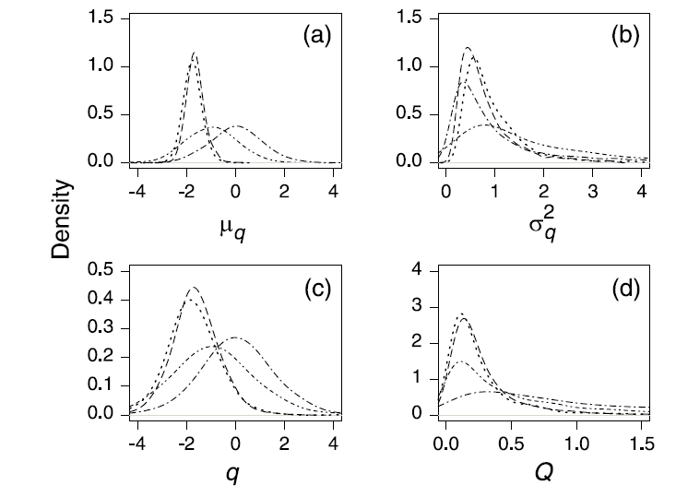
Results-I

Slide 34
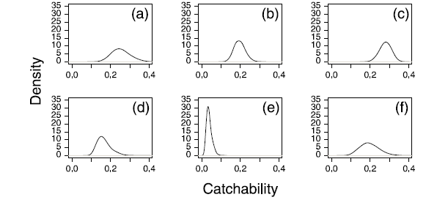
Results-II
(a) bocaccio, (b) canary (south), (c) canary (north), (d) chilipeper,
(e) widow, (f) yellowtail

Slide 35


Comments Arising
Outcomes:
  A posterior for survey catchability:
  These posteriors have formed the basis for discussions when conducting assessments but have yet to be used for actual assessments of “unassessed” species.
  Strong evidence that Q is less than 1 and that survey catchability changes systematically among years.

Slide 36
Comments Arising
Questions with the analysis:
  Are the species / stocks interchangable (these are all shelf species, but widow is also found in mid-water)?
  Is a simple population model (one fleet; many known parameters including recruitment) appropriate?

